Slide 1
Exploring Factors Affecting Homicide Rates In Countries
Group 11

Slide 2
Introduction
Dataset: Country data from Kaggle
The total number of observations are 169
The predictor variables are urban population growth, internet users, GDP per capita, refugees, and population growth.
The study seeks to predict homicide rates based on these factors.
Some data points are missing or repeated.
Uncertainty about when the dataset was created.

Slide 3
FINDINGS FROM SIMPLE LINEAR REGRESSION MODELS
Model Formula | Intercept | Slope | R² | P-value
Homicide Rate~GDP | 7.329 | -4.053*10⁷ | 0.006004 | 0.318
Homicide Rate~Urban Population Growth | 6.7657 | 0.1666 | 0.0008061 | 0.714
Homicide Rate~Internet Users | 10.89886 | -0.06505 | 0.0291 | 0.0275**
Homicide Rate~GDP per capita | 8.562 | -8.282*10⁵ | 0.04619 | 0.00515**
Homicide Rate~Refugees | 6.55575 | 0.000873 | 0.01022 | 0.205
Key Insights:​
GDP and urban population growth both show low R² and insignificant p-values (p>0.05), indicating no significant relationship with the homicide rate.
The refugee population variable also showed no significant relationship (p=0.205).
Despite having significant p-values (p<0.05), internet users and GDP per capita explain only small portions of the variance (R²=0.029 & 0.0460,respectively).

Slide 4
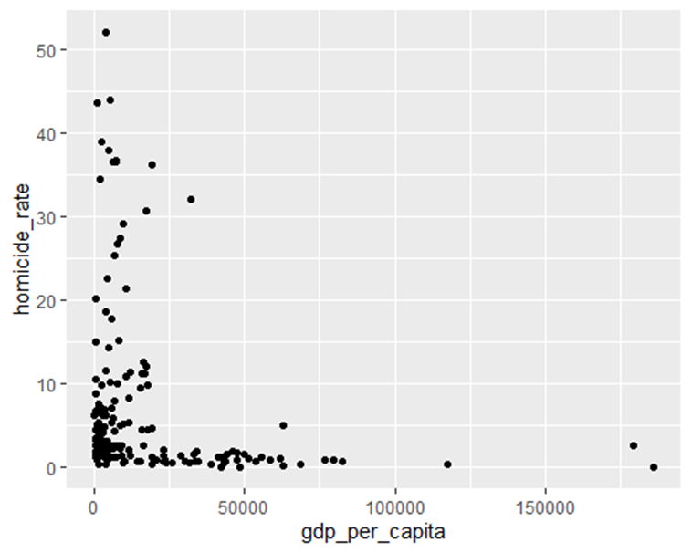
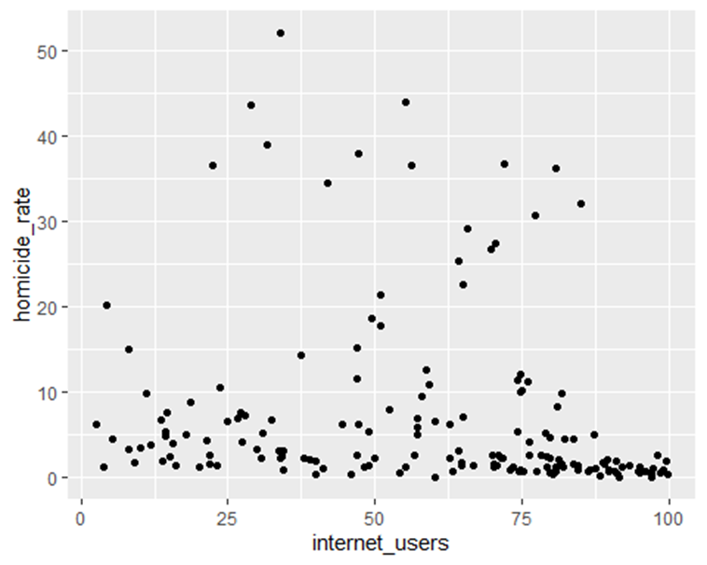
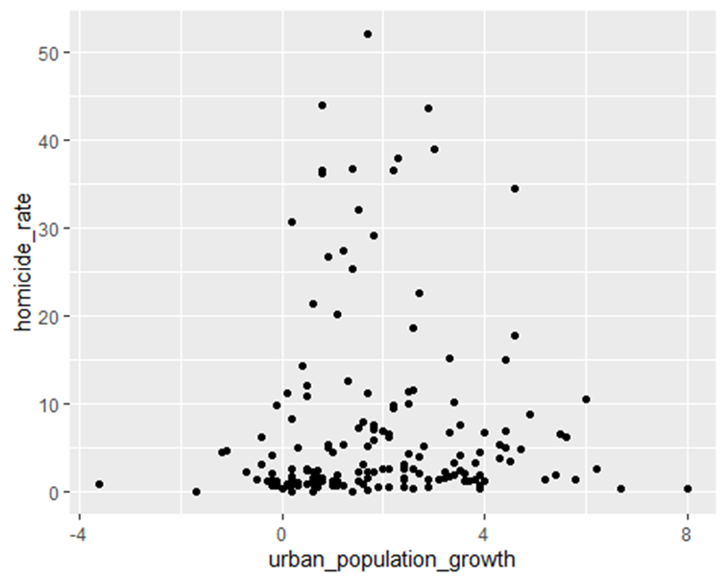
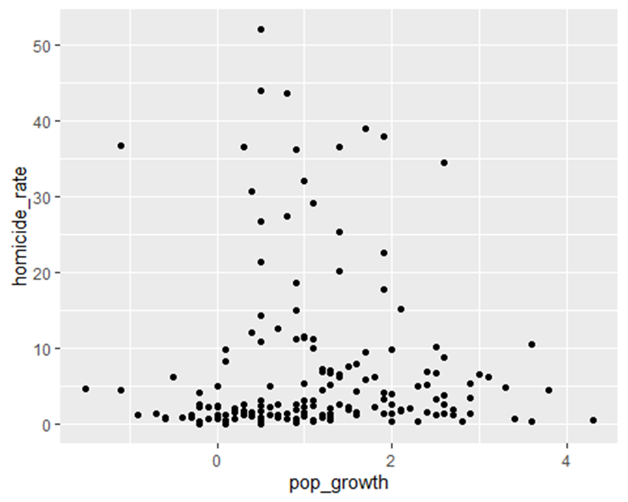
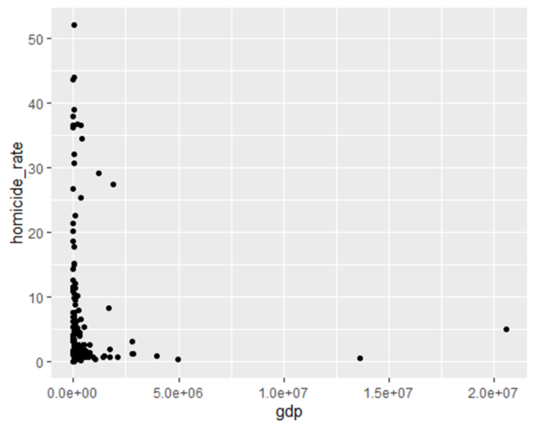
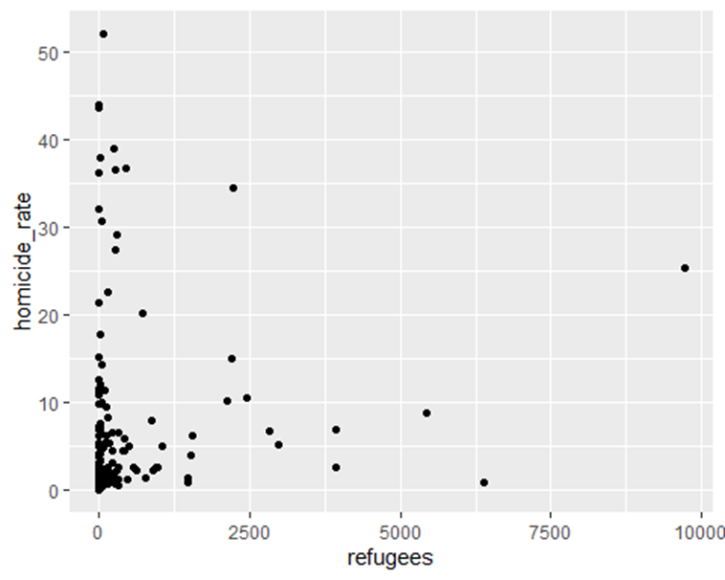
Association Analysis
Plotted the predictors against homicide rate
Scatterplots seem to indicate nonlinear and non-monotonic relationships
Not suitable for testing with Spearman's Rank Correlation
Perform transformations on the data

Slide 5
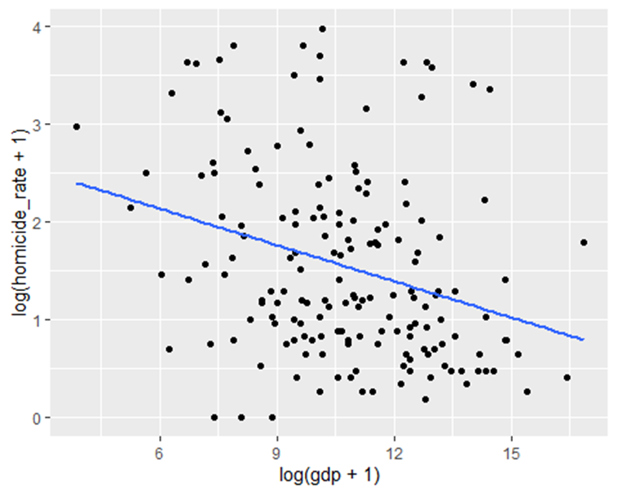
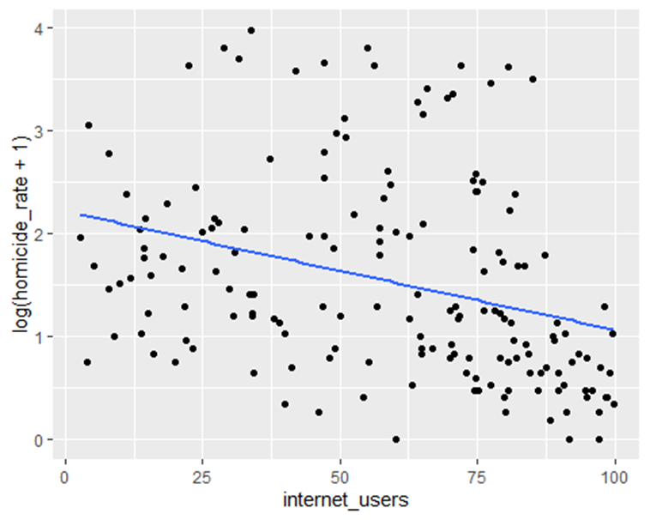
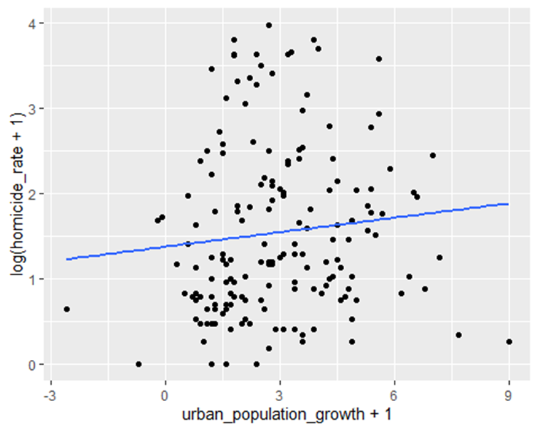
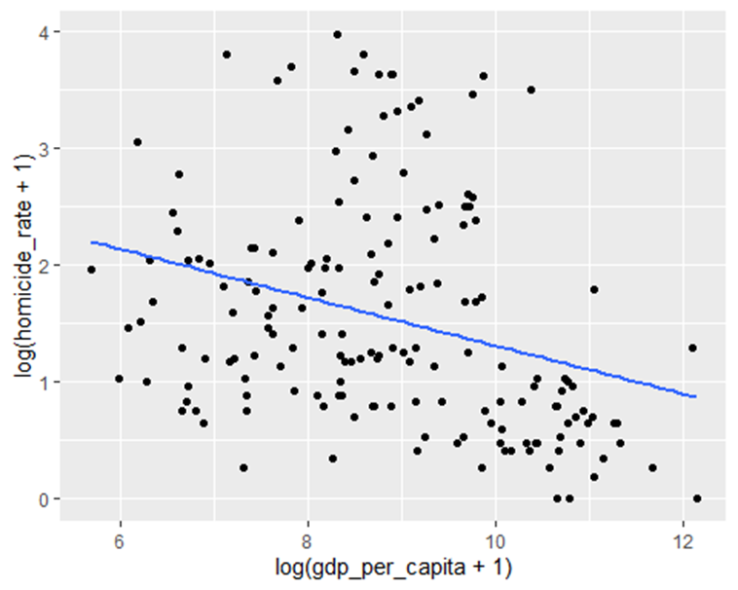
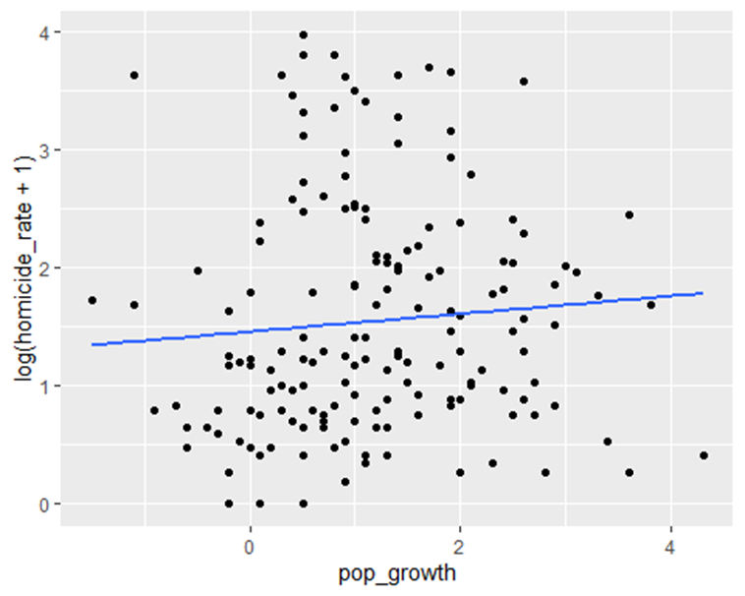
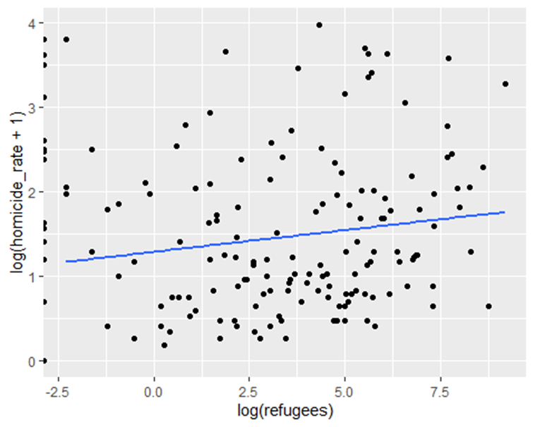
Association Analysis
After performing several different transformations, settled with log transformations on X and/or Y for best results
Plots display weak to moderate linear correlations now, both positive and negative. Added lines for visual aid
Suitable for testing with Pearson's correlation

Slide 6
Association Analysis Testing & Results
Transformed Variables | p-value | Pearson's r value | Statistically Significant
log(Homicide Rate) vs log(GDP) | 0 | -0.2951072 | Yes
log(Homicide Rate) vs Urban Population Growth | .186 | 0.1014501 | No
log(Homicide Rate) vs Population Growth | .268 | 0.08182263 | No
log(Homicide Rate) vs Internet Users | 0 | -0.3205548 | Yes
log(Homicide Rate) vs log(GDP Per Capita) | 0 | -0.3025433 | Yes
log(Homicide Rate vs log(Refugee Population) | .522, | 0.05412809 | No
After performing several different transformations, settled with log transformations on X and/or Y for best results
Plots display weak to moderate linear correlations now, both positive and negative. Added lines for visual aid
Suitable for testing with Pearson's correlation
Results:​​
log(Homicide Rate) vs log(GDP), log(Homicide Rate) vs Internet Users, log(Homicide Rate) vs log(GDP Per Capita) show statistically significant correlations.
This suggests these variables are associated, but in a non-linear manner, when the transformations are reversed.

Slide 7
ANOVA TABLE
Purpose:
Assess which variables significantly influence homicide rates.
Predictor | F Value | P Value | Significance
Urban Pop. Growth | 0.291 | 0.5905 | Not significant
Pop. Growth | 0.325 | 0.5695 | Not significant
Internet Users | 4.930 | 0.0279 | Significant
GDP | 0.539 | 0.4640 | Not significant
Refugees | 1.159 | 0.2934 | Not significant
GDP per capita | 2.095 | 0.1499 | Not significant
Key findings:
Only internet users significantly impacts homicide rate
p = 0.0279
Other predictors do not show statistical significance.
Increased internet access may correlate with lower homicide rates.

Slide 8
Multicollinearity Check
Purpose:
Ensure no strong correlations exist among predictors to maintain model reliability.
VIF Analsis:
All VIF values < 3.5 (acceptable range).
Highest VIF: pop. Growth (3.41)
Condition Number = 14.65
Conclusion:
No significant multicollinearity detected.
Predictors are suitable for inclusion in further analysis.
Variable | VIF
GDP | 1.05
Urban population growth | 3.07
Population growth | 3.41
Internet users | 2.14
GDP per capita | 1.65
Refugees | 1.04

Slide 9
Multiple Linear Regression Model
Model Formula: Homicide Rate~ GDP + Urban Population Growth + Internet Users+ GDP per capita + Refugees
Coefficients | Estimate | P-value
Intercept | 10.30 | 0.515803
GDP | -2.636*10⁻⁷ | 0.581670
Urban Population Growth | 4.411*10⁻¹ | 0.330743
Internet Users | -3.196*10⁻² | 0.458763
GDP Per Capita | -5.472*10⁻⁵ | 0.149868
Refugees | 6.846*10⁻⁴ | 0.327385
Key Insight: All the predictors have insignificant p-values(p>0.05), meaning no predictor shows a strong, statistically significant relationship with the homicide rate in the presence of others.

Slide 10
Conclusion
Three out of the six predictors' variable predicted homicide rate.
GDP
Internet users.
GDP Per capita

